Slide 1
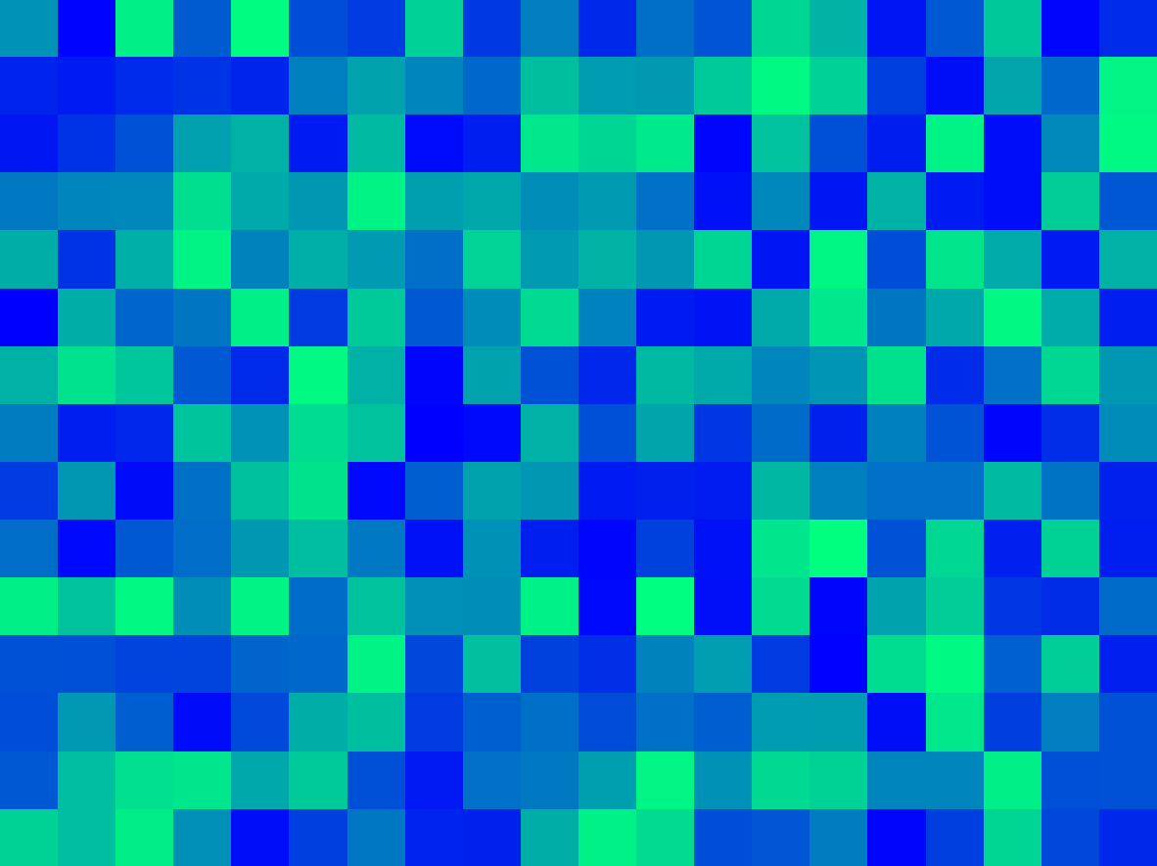
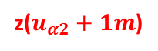
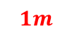
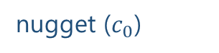
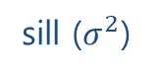
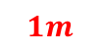
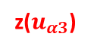
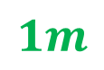
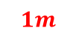
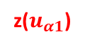
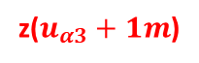
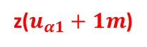

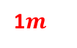
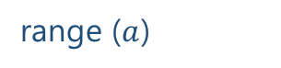

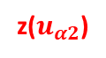
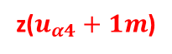
$$1m$$
variance ($γ$)
z($u_{α1}$)
z($u_{α1}+1m$)
sill ($σ^{2}$)
$$1m$$
$$1m$$
1$m$
nugget ($c_{0}$)
z($u_{α4}$)
z($u_{α4}+1m$)
z($u_{α2}$)
z($u_{α2}+1m$)
$$1m$$
range ($a$)
z($u_{α3}$)
z($u_{α3}+1m$)
lag distance (h)

Slide 2
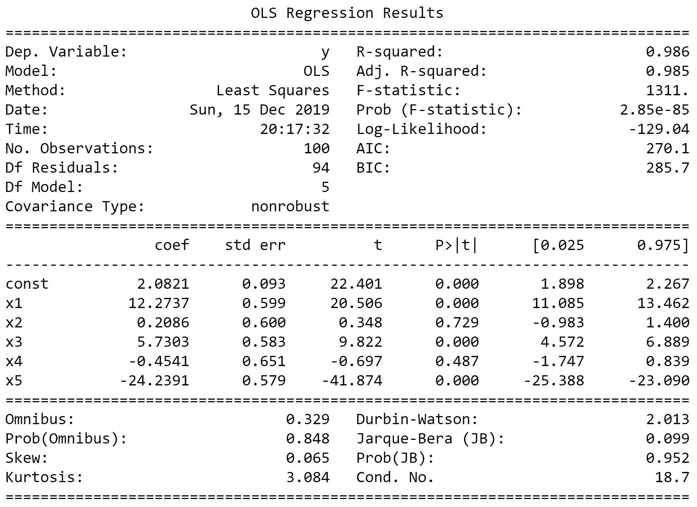
Wrong, due to overestimated std err
aegis4048.github.io

Slide 3
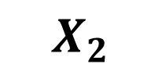
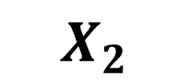
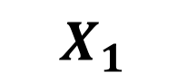
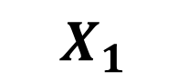
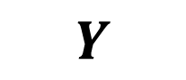
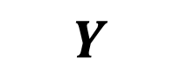
$$X_{1}$$
$$Y$$
$$X_{2}$$
$$X_{2}$$
$$X_{1}$$
$$Y$$
aegis4048.github.io
aegis4048.github.io
A. No Multicollinearity
B. Direct & High Multicollinearity

Slide 4
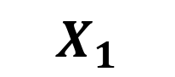
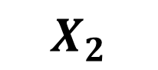
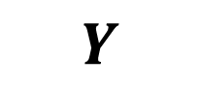
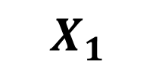
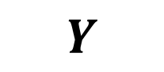
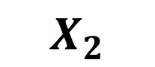
$$X_{1}$$
$$X_{2}$$
$$X_{1}$$
$$Y$$
$$X_{2}$$
aegis4048.github.io
aegis4048.github.io
$$Y$$
C. Indirect & Low Multicollinearity
D. Direct & Low Multicollinearity

Slide 5
Feature of Interest
Collinear Feature
Outcome
Temperature
Positive
Bacteria A
Negative
Bacteria A
aegis4048.github.io
Positive
Toxic Chem.
???
Bacteria B
???
Bacteria A
aegis4048.github.io
aegis4048.github.io
Negative
Bacteria B
Positive
Temperature
Positive
Bacteria A
Negative
aegis4048.github.io

Slide 6
Feature of Interest
Outcome
Temperature
Positive
Bacteria A
Toxic Chem.
Negative
aegis4048.github.io
Bacteria A

Slide 7
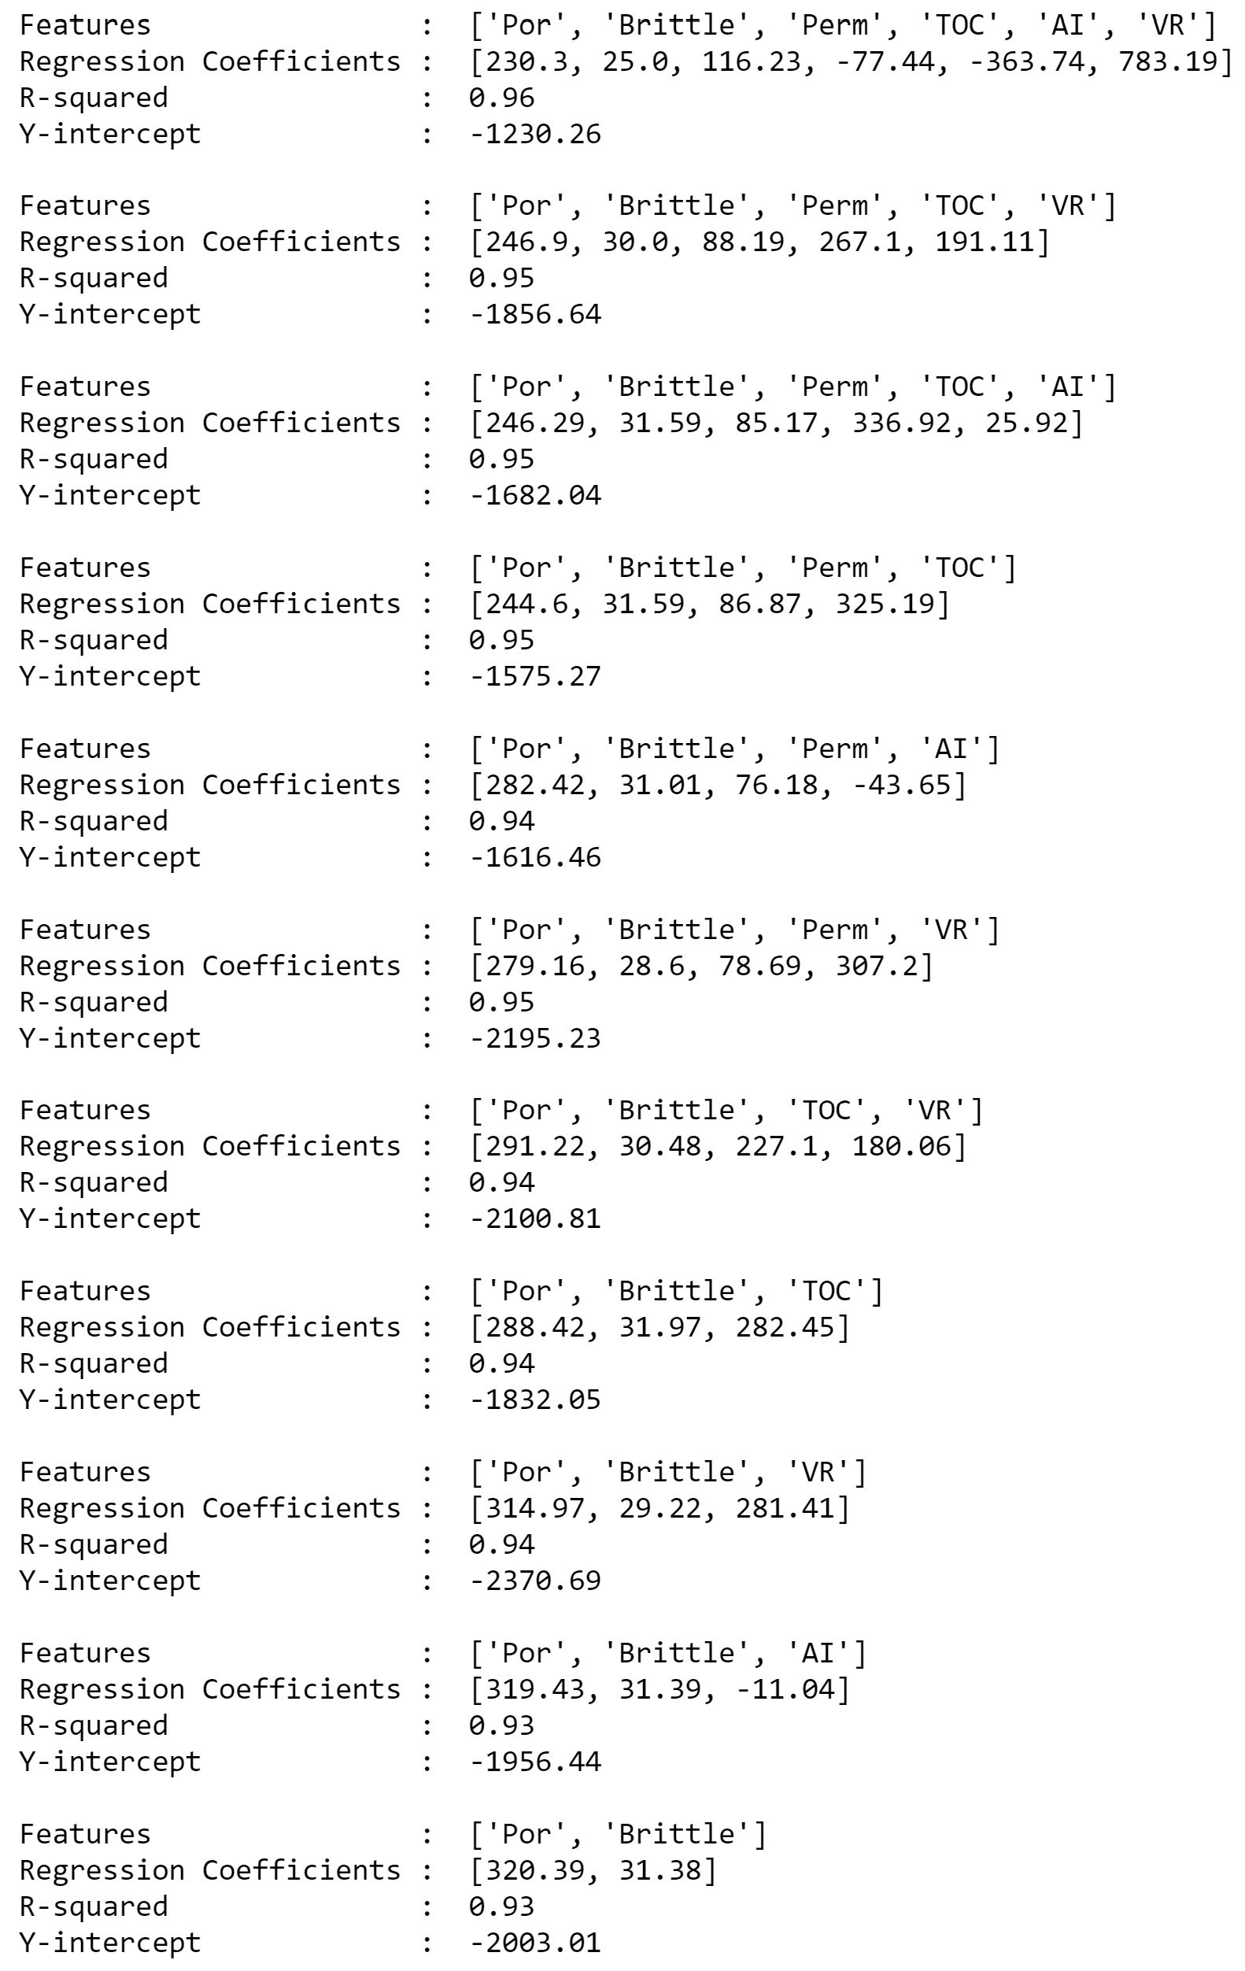
aegis4048.github.io
aegis4048.github.io
Unstable regression coefficient values for ‘Por’

Slide 8
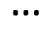
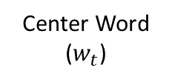
Feature vector
Center Word
($w_{t}$)
man passes sentence should swing sword the who
The
0 0 0 0 0 0 1 0
man
1 0 0 0 0 0 0 0
who
0 0 0 0 0 0 0 1
aegis4048.github.io
sword
0 0 0 0 0 1 0 0

Slide 9
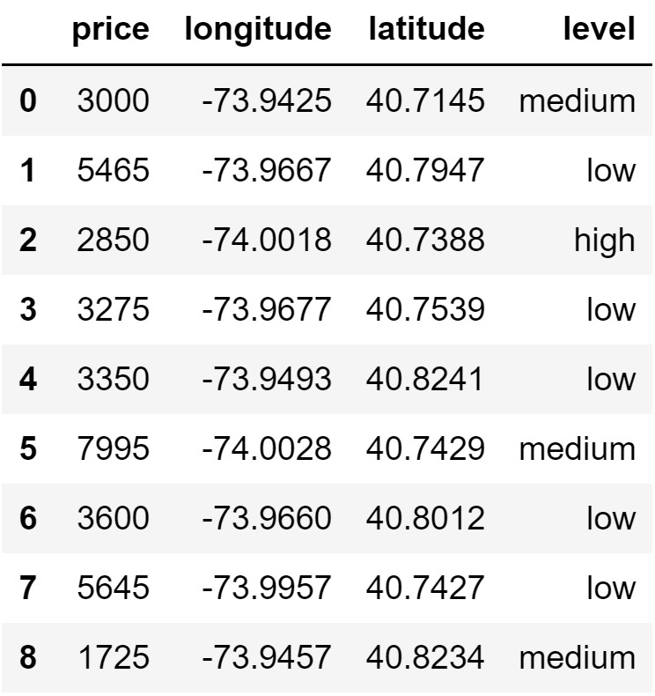
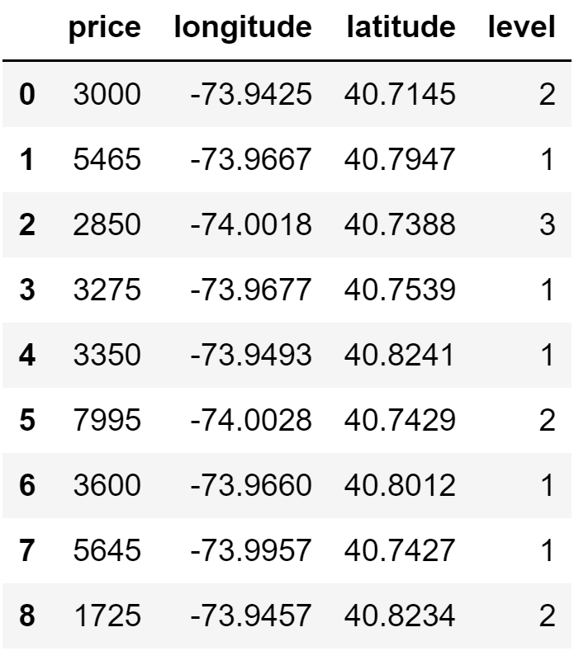
aegis4048.github.io
aegis4048.github.io

Slide 10
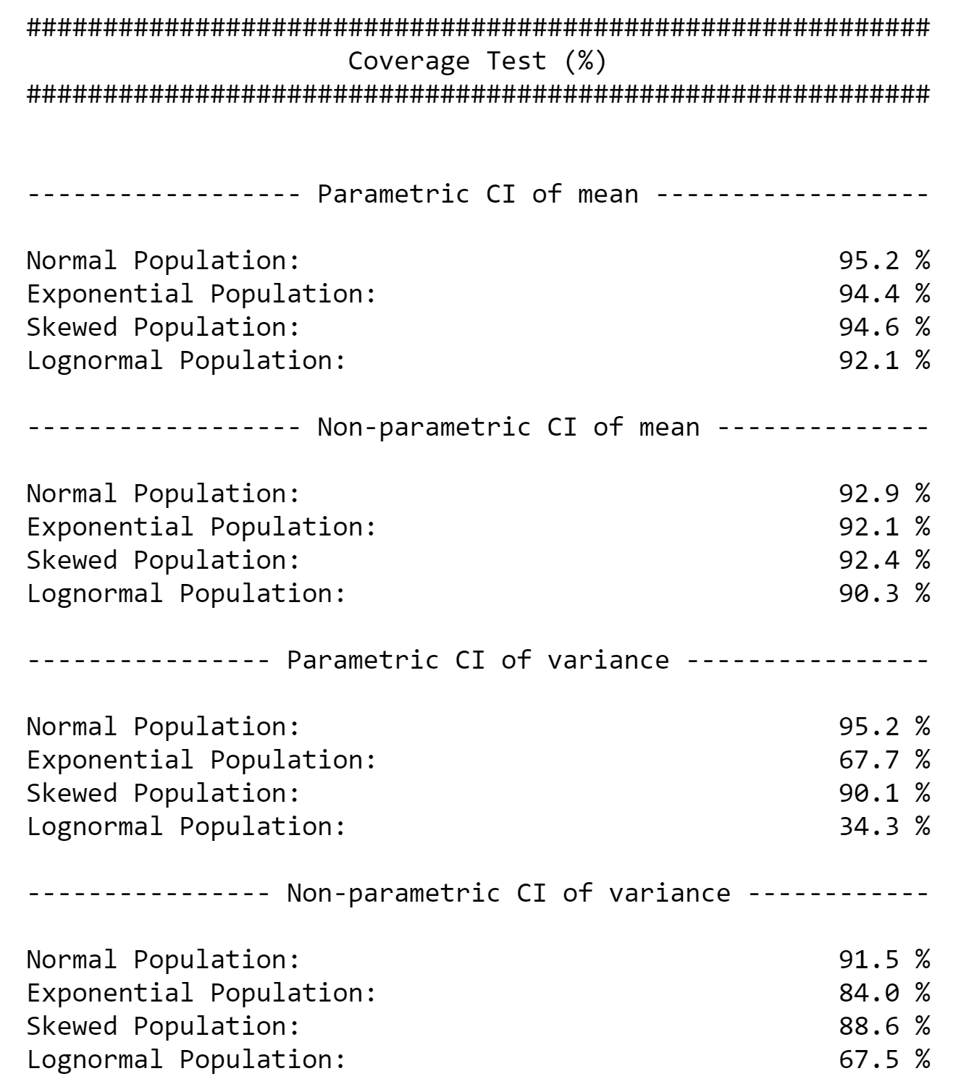
aegis4048.github.io

Slide 11
Direct Sampling
Bootstrap Resampling
VS.
5
7
8
5
12
17
8
11
13
6
4
15
6
2
3
4
10
2
9
14
1
16
Bootstrap population = Original sample
Population
aegis4048.github.io
6
5
5
6
6
5
4
2
4
2
6
8
5
4
8
8
2
8
8
2
5
5
4
4
2
8
6
6
2
Bootstrap
sample (n=5)
Bootstrap
sample (n=5)
Bootstrap
sample (n=5)
Bootstrap
sample (n=5)
Bootstrap
sample (n=5)
4
Mean = 5.2
Mean = 4.2
Mean = 5.2
Mean = 5.0
Mean = 5.4
Original sample
Bootstrap Samples
ANALYSIS
ANALYSIS

Slide 12
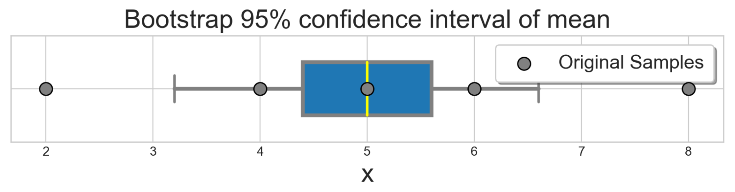


8
5
Original sample (n=5)
6
2
4
Monte-Carlo iteration of bootstrap $r=6$ times
aegis4048.github.io
6
6
6
5
8
5
5
8
4
6
2
4
2
8
6
4
8
8
2
8
5
2
5
4
4
2
8
6
8
2
Bootstrap
sample (n=5)
Bootstrap
sample (n=5)
Bootstrap
sample (n=5)
Bootstrap
sample (n=5)
Bootstrap
sample (n=5)
Bootstrap
sample (n=5)
Mean = 5.2
Mean = 4.2
Mean = 5.2
Mean = 5.0
Mean = 5.4
Mean = 6.4
aegis4048.github.io
$r=6$ bootstrap sample means

Slide 13
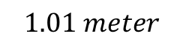
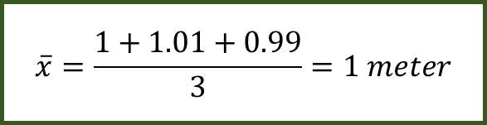
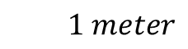
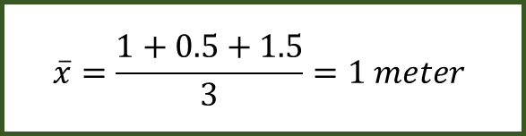
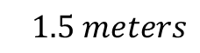
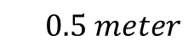
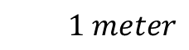
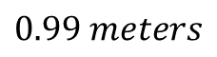
$$1 meter$$
$$\overline{x}=\frac{1+0.5+1.5}{3}=1 meter$$
$$0.5 meter$$
$$1.5 meters$$
aegis4048.github.io
$$1 meter$$
$$\overline{x}=\frac{1+1.01+0.99}{3}=1 meter$$
$$1.01 meter$$
$$0.99 meters$$
aegis4048.github.io

Slide 14
Mode 1
Mode 2
Median 1
Median 2
Mean 1
Mean 2
Overlap of 95% Conf. Int. of Means
aegis4048.github.io

Slide 15
Mean
Median
Fig (a)
Fig (b)
Mode
Mode
Median
Mean
95% Conf. Int. of Mean
95% Conf. Int. of Mean
aegis4048.github.io
aegis4048.github.io

Slide 16
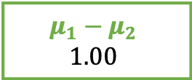
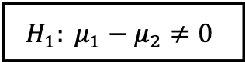
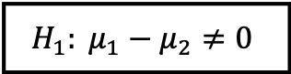
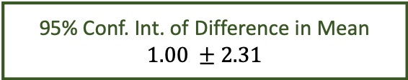
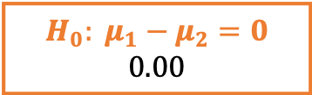
95% chance that difference in mean
falls between -1.31 and 3.31
Lower Limit
Lower Limit
-1.31
3.31
95% Conf. Int. of Difference in Mean
$$1.00 ±2.31$$
$$H_{0}: μ_{1}−μ_{2}=0$$
$$0.00$$
aegis4048.github.io
$$H_{1}: μ_{1}−μ_{2}≠0$$
$$H_{1}: μ_{1}−μ_{2}≠0$$
$$μ_{1}−μ_{2}$$
$$1.00$$
2.5%
outliers
2.5%
outliers

Slide 17
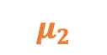



Similar “enough”
“Significantly” different
aegis4048.github.io
aegis4048.github.io
$$μ_{1}$$
$$μ_{2}$$
$$μ_{1}$$
$$μ_{2}$$

Slide 18



























Population
Samples
aegis4048.github.io
sample set 1
aegis4048.github.io
aegis4048.github.io
sample set 2

Slide 19


Depends on type of distribution. Tells how many standard deviation away is the limit from the center
point estimate $±$ (dist.score $×$ SE)
= 12.32 $±$ (1.96 $×$ 1.816)
= 12.32 $±$ 3.56
Depends on type of statistic you want to compute.
For sample mean ($\overline{x}$): ${SE}_{\overline{x}}=s/{\sqrt{N}}$
For sample proportion ($p$): ${SE}_{p}=\sqrt{{p(1−p)}/N}$

Slide 20



Distribution of Population
falls between 4.70 and 24.42
Lower Limit
Lower Limit
4.70
24.42
95% Conf. Int. of Mean
$$12.32 ±3.56$$
$$8.76 \sim 15.88$$
Population Mean (unknown)
$$14.56$$
Sample Mean
$$12.32$$
aegis4048.github.io

Slide 21














Lower Limit
95% chance that population mean
falls between 8.76 and 15.88
Upper Limit
8.76
15.88
95% Conf. Int. of Mean $=12.32 ±3.56$
$$−3.56$$
$$+3.56$$
$$−(dist.score×SE)$$
$$+(dist.score×SE)$$
aegis4048.github.io
3.56 = distribution score $×$ Standard Error
2.5%
outliers
2.5%
outliers
Sample Mean = $12.32$
$$μ_{1}$$
$$μ_{2}$$
5% chance
$$μ_{3}$$
$$μ_{4}$$
$$μ_{5}$$
$$μ_{6}$$
$$μ_{7}$$

Slide 22


100% chance that your clip length
falls between 2cm and 3cm
2.?? cm
depends on tick mark spacing
1
2
3
4
5
6
7
8
point estimate $±$ measurement E.
2.5 $±$ 0.5 cm
cm
aegis4048.github.io

Slide 23

aegis4048.github.io
aegis4048.github.io

Slide 24


Slide 25

aegis4048.github.io
aegis4048.github.io

Slide 26

aegis4048.github.io
aegis4048.github.io

Slide 27

aegis4048.github.io
aegis4048.github.io

Slide 28

aegis4048.github.io
aegis4048.github.io

Slide 29

aegis4048.github.io
aegis4048.github.io

Slide 30

aegis4048.github.io
aegis4048.github.io

Slide 31

aegis4048.github.io
aegis4048.github.io

Slide 32

aegis4048.github.io
aegis4048.github.io

Slide 33

aegis4048.github.io
aegis4048.github.io

Slide 34

aegis4048.github.io
aegis4048.github.io

Slide 35

aegis4048.github.io

Slide 36

aegis4048.github.io

Slide 37


Binomial Classification
(regression, logistic)
(regression, zebra)
(regression, machine)
(regression, pimples)
(regression, sigmoid)
VS
(regression, Gangnam-Style)
(regression, supervised)
(regression, toothpaste)
aegis4048.github.io
(regression, neural)
(regression, idiot)
Likely to observe
$$p(D=1|w,c_{pos})≈1$$
Unlikely to observe
$$p(D=1|w,c_{neg})≈0$$

Slide 38



True: $σ\left(x\right)$ > 0.5
False: $σ\left(x\right)$ < 0.5
aegis4048.github.io

Slide 39

aegis4048.github.io
aegis4048.github.io

Slide 40










Center word: drilling
$$K=5$$
$$iter=1$$
$$iter=2$$
$$iter=3$$
$$iter=4$$
Current context word: engineer
$$p\left(D=1 | w_{drilling},c_{engineer}\right)$$
$$p(D=1|w_{drilling},c_{minimized})$$
$$p(D=1|w_{drilling},c_{primary})$$
$$p(D=1|w_{drilling},c_{concerns})$$
$$p(D=1|w_{drilling},c_{led})$$
$$p\left(D=1 | w_{drilling},c_{page}\right)$$
0.432
0.312
0.565
0.102
0.853
0.642
0.653
0.169
0.221
0.043
0.532
0.380
0.853
0.042
0.083
0.009
0.115
0.101
0.998
0.000
0.001
0.000
0.001
0.002
engineer
minimized
Update $θ$
Update $θ$
Update $θ$
primary
$$=$$
concerns
led
aegis4048.github.io
aegis4048.github.io
aegis4048.github.io
page

Slide 41
Drilling fluids serve to balance formation pressures while drilling to ensure wellbore stability. They also carry cuttings to the surface and cool the bit. The drilling engineer traditionally designs drilling fluids with two primary goals in mind:
To ensure safe, stable boreholes, which is accomplished by operating within an acceptable mud-weight window
To achieve high rates of penetration so that rig time and well cost can be minimized
These primary considerations do not include well productivity concerns. A growing recognition of the importance of drilling-induced formation damage has led to the use of drill-in fluids (fluids used to drill through the pay zone) that minimize formation damage. This page discusses the formation damage that may be associated with various types of drilling fluids.
current context word
aegis4048.github.io
aegis4048.github.io

Slide 42

Vanilla Skip-Gram
aegis4048.github.io
aegis4048.github.io
Negative Sampling
aegis4048.github.io
aegis4048.github.io

Slide 43




Complexity = $O\left(V+V\right)≈O\left(V\right)$
where $V$ is very large
Computed $V$ times
for all vocabs
aegis4048.github.io
$V$ computations are needed to get normalization factor

Slide 44

aegis4048.github.io

Slide 45

aegis4048.github.io

Slide 46

aegis4048.github.io
aegis4048.github.io
aegis4048.github.io

Slide 47

aegis4048.github.io
aegis4048.github.io
aegis4048.github.io

Slide 48

aegis4048.github.io

Slide 49

aegis4048.github.io
aegis4048.github.io
aegis4048.github.io

Slide 50

aegis4048.github.io
aegis4048.github.io
aegis4048.github.io

Slide 51





$$iter=1$$
$$iter=2$$
$$iter=3$$
$$iter=4$$
0.24
0.42
0.20
0.12
-0.74
-0.82
0.18
0.30
0.12
0.09
-0.32
-0.46
0.08
0.12
0.04
0.02
-0.12
-0.13
0.01
0.02
0.01
0.00
-0.01
-0.02
man
$$\sum_{c=1}^{C}{e_{c}}=$$
passes
Update $θ$
Update $θ$
Update $θ$
sentence
should
aegis4048.github.io
aegis4048.github.io
the
who

Slide 52





$$c=1$$
$$c=2$$
0.12
0.21
0.10
0.06
-0.87
0.09
0.12
0.21
0.10
0.06
0.13
-0.91
0.24
0.42
0.20
0.12
-0.74
-0.82
man
passes
$$\sum_{c=1}^{C}{e_{c}}=$$
sentence
$$+$$
$$=$$
should
aegis4048.github.io
the
who

Slide 53






$$y_{true}$$
($V$-dim)
$$y_{pred}−y_{true}$$
($V$-dim)
0
0
0
0
1
0
0.12
0.21
0.10
0.06
-0.87
0.09
man
$$y_{pred}$$
($V$-dim)
passes
sentence
$$=$$
should
0.12
0.21
0.10
0.06
0.13
0.09
$$−$$
c = 1
the
who
aegis4048.github.io
0
0
0
0
0
1
0.12
0.21
0.10
0.06
0.13
-0.91
man
$$−$$
passes
sentence
$$=$$
should
c = 2
the
who

Slide 54
Dimension 3
0.11
0.34
0.54
Achieve
Achieve
Success
aegis4048.github.io
aegis4048.github.io
0.51
0.91
0.65
Success
Dimension 1
Vector distance
Dimension 2

Slide 55
Training Samples
Source Text
The
man
who
passes
the
sentence
should
swing
the
sword.
(passes, who)
(passes, the)

Slide 56
Dimension 3
should
passes
0.1 0.2 0.7
passes
aegis4048.github.io
should
-2 0.2 0.8
aegis4048.github.io
Dimension 1
Dimension 2

Slide 57





Makes it positive
$$W_{output}∙h$$
Softmax ($W_{output}∙h$)
$$y_{pred}$$
-1.23
0.33
0.18
-5.12
-8.79
-2.01
2.56
4.31
0.12
0.08
0.02
0.13
0.23
0.15
0.11
0.16
$$p\left(y_{i}\right)=\frac{e^{y_{i}^{}}}{\sum_{j}{e^{y_{j}}}}$$
aegis4048.github.io
Normalizes to range [0, 1]
Sum($y_{pred})$ = 1

Slide 58

$$W_{input}$$
($V×N$)
man
2 0.5 4
0.1 0.2 0.7
0.3 -2 0.2
-2 0.2 0.8
1 0.7 3
3 5 0.2
passes
sentence
should
aegis4048.github.io
the
who

Slide 59




$$y_{true}$$
($V$-dim)
$$y_{pred}−y_{true}$$
($V$-dim)
0
0
0
0
1
0
0.12
0.21
0.10
0.06
-0.87
0.09
man
$$x$$
($V$-dim)
$$W_{input}$$
($V×N$)
$$h$$
($N$-dim)
$$W_{output}^{T}$$
($N×V$)
$$y_{pred}$$
($V$-dim)
passes
sentence
$$=$$
should
man
0
1
0
0
0
0
2 0.5 4
0.1 0.2 0.7
0.3 -2 0.2
-2 0.2 0.8
1 0.7 3
3 5 0.2
0.12
0.21
0.10
0.06
0.13
0.09
$$−$$
c = 1
passes
the
sentence
0.1
0.2
0.7
0.3 0.1 0.4 -0.4
0.1 0.3 -1.1 0.3
0.1 0.2 0.4 0.1
who
should
aegis4048.github.io
aegis4048.github.io
0
0
0
0
0
1
0.12
0.21
0.10
0.06
0.13
-0.91
man
the
$$−$$
passes
who
sentence
$$=$$
should
c = 2
Input Layer one-hot encoded vector
Word-Embedding matrix – a.k.a “Lookup table”
Hidden (Projection)
Layer for center word (passes)
Word-Embedding matrix for context words (the, who)
Softmax Output
Layer of range
[0, 1)
Sum = 1
the
who
Prediction Error – a.k.a function loss

Slide 60





$$x$$
($V$-dim)
$$W_{input}$$
($V×N$)
$$h$$
($N$-dim)
man
0
1
0
0
0
0
2 0.5 4
0.1 0.2 0.7
0.3 -2 0.2
-2 0.2 0.8
1 0.7 3
3 5 0.2
passes
sentence
0.1
0.2
0.7
Projection of word vector for “passes” from the embedding matrix
should
$$×$$
$$=$$
aegis4048.github.io
the
who

Slide 61







Input Layer ($x$)
($V$-dim)
Assuming Stochastic Gradient Descent…
Center Word
($w_{t}$)
v=0
v=1
v=2
v=3
v=4
v=5
v=6
v=7
man passes sentence should swing sword the who
t=0
The
0 0 0 0 0 0 1 0
t=0
$$θ_{new}=θ_{old}−η∙∇_{θ}J_{0}(θ;w^{(0)})$$
t=1
man
1 0 0 0 0 0 0 0
$$θ_{new}=θ_{old}−η∙∇_{θ}J_{1}(θ;w^{(1)})$$
t=2
who
0 0 0 0 0 0 0 1
$$θ_{new}=θ_{old}−η∙∇_{θ}J_{2}(θ;w^{(2)})$$
aegis4048.github.io
aegis4048.github.io
t=9
sword
0 0 0 0 0 1 0 0
$$θ_{new}=θ_{old}−η∙∇_{θ}J_{9}(θ;w^{(9)})$$

Slide 62



Slide 63

killowatt
electricity
aegis4048.github.io
aegis4048.github.io
Oil Producers
Barrels + bpd

Slide 64

Oil Producers
Barrels + bpd
killowatt
electricity
aegis4048.github.io

Slide 65

electricity
killowatt
Barrels + bpd
Oil Producers
aegis4048.github.io

Slide 66
0
0
0.32
0.79
0
0.05
0.10
0
0
0.91
Achieve
aegis4048.github.io
aegis4048.github.io
0
0
0.34
0.75
0
0.10
0
0
0
0.87
Success

Slide 67
Dimension 3
0.11
0.34
0.54
Achieve
Achieve
Success
aegis4048.github.io
aegis4048.github.io
0.51
0.91
0.65
Success
Dimension 1
Dimension 2

Slide 68

aegis4048.github.io

Slide 69













2$m$
variance ($γ$)
sill ($σ^{2}$)
z($u_{α1}$)
z($u_{α1}+2m$)
2$m$
2$m$
2$m$
z($u_{α4}$)
z($u_{α4}+2m$)
nugget ($c_{0}$)
z($u_{α2}$)
z($u_{α2}+2m$)
2$m$
range ($a$)
range
z($u_{α3}$)
z($u_{α3}+2m$)
lag distance (h)

Slide 70









3$m$
variance ($γ$)
sill ($σ^{2}$)
z($u_{α1}$)
z($u_{α1}+3m$)
3$m$
3$m$
z($u_{α3}$)
z($u_{α3}+3m$)
nugget ($c_{0}$)
range ($a$)
3$m$
range
z($u_{α2}$)
z($u_{α2}+3m$)
lag distance (h)

Slide 71




variance ($γ$)
sill ($σ^{2}$)
nugget ($c_{0}$)
range ($a$)
lag distance (h)

Slide 72


z($u_{α}$)
h
z($u_{α}+h$)

Slide 73








h
z($u_{α1}$)
z($u_{α1}+h$)
h
h
z($u_{α2}$)
z($u_{α2}+h$)
z($u_{α1}$)
z($u_{α}+h$)
h
z($u_{α3}$)
z($u_{α3}+h$)

Slide 75
Y axis (North)
Lag Tolerance
Lag 3
Azimuth
Lag 2
Bandwidth
Lag 1
Azimuth Tolerance
X axis (East)

Slide 76

Z axis (vertical)
Horizontal Major
Horizontal Major
Azimuth
Horizontal Minor
Horizontal Minor
Horizontal Minor
$$θ$$
X axis (East)
Y axis (North)

Slide 77
Y axis (North)
Lag 3
Lag 2
Lag 1
X axis (East)

Slide 78

aegis4048.github.io
aegis4048.github.io
aegis4048.github.io
aegis4048.github.io

Slide 79

aegis4048.github.io

Slide 80

aegis4048.github.io

Slide 81

aegis4048.github.io

Slide 82

aegis4048.github.io

Slide 83

aegis4048.github.io
aegis4048.github.io

Slide 84

aegis4048.github.io

Slide 85

aegis4048.github.io

Slide 86


